Slide 1

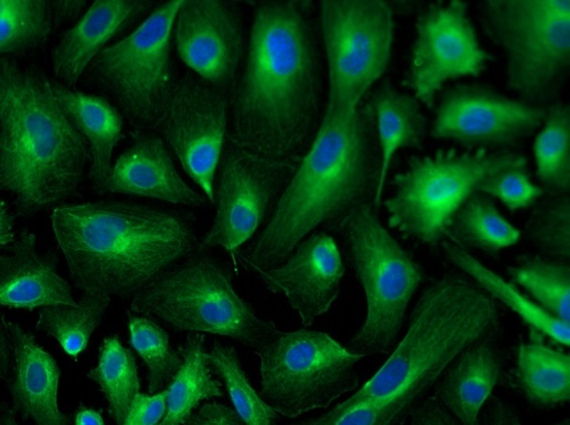
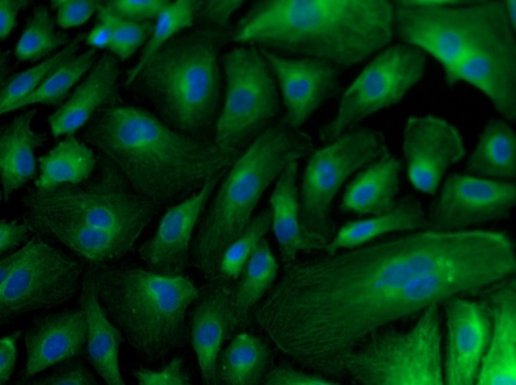
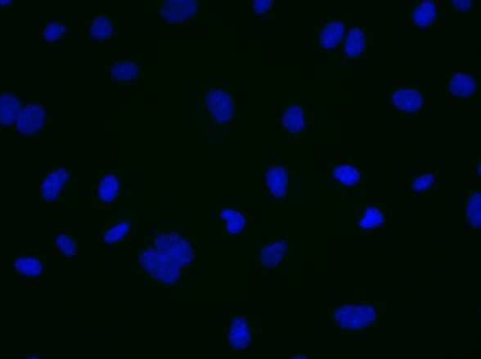
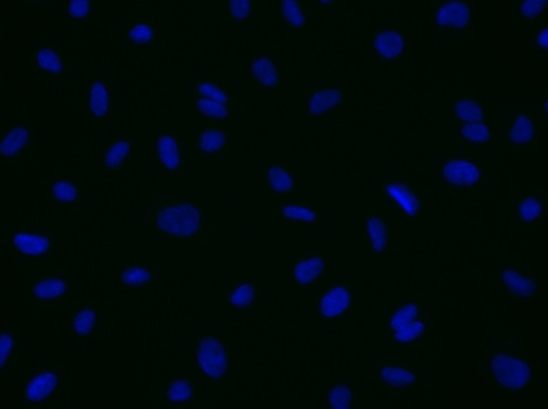
ReliaTech GmbH
Mouse anti-human VEGF-A (#7G7)
mouse anti-human VEGF-A
mouse anti-human VEGF-A
Control (goat anti-mouse IgG ALEXA Flour 488; 1:600)
Immunofluorescence staining of VEGF-A in human umbilical vein endothelial cells (HUVEC) with the monoclonal mouse anti-human VEGF-A #7G7 [Cat# 101-M58] antibody (upper panel). Control with goat anti-mouse ALEXA Flour 488 [Dianova] (lower panel). [IF_HU1407-01; 101-M58 (7,5µg/ml) 400X;]
http://www.reliatech.de / info@reliatech.de

